Slide 1
GROUP : 5 BOOK RECOMMENDATION SYSTEM
Team Member
Mr. Aditya Patil
Mrs.Yamini Bansode
Shivakumar Avunuri

Slide 2
Content
Problem statement
Data importing
Exploratory data analysis (EDA)
Data cleaning
Feature engineering
Popularity Based Recommender System
Collaborative Filtering Based Recommender System
Deployment

Slide 3

Problem Statement
During the last few decades, with the rise of YouTube, Amazon, Netflix, and many other such web services, recommender systems have become much more important in our lives in terms of providing highly personalized and relevant content
Generate the features from the dataset and use them to recommend the books accordingly to the users.

Slide 4
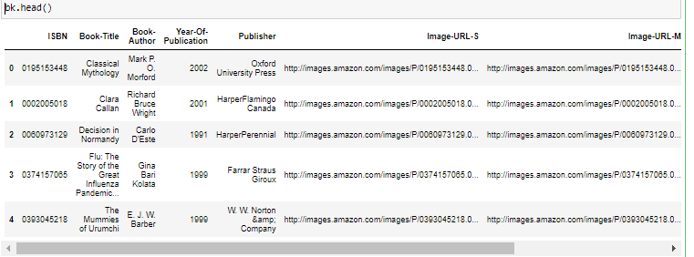
BOOKS Data Set
In books data set we can see the column of isbn, Book-title, book-Author, year-of-publication, publisher Image-URL-S,Image-URL-L.

Slide 5
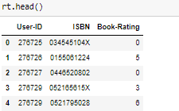
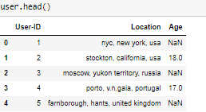
Users & Ratings data set
In ratings data set we can see User-Id, ISBN, Book-Rating column
In Ratings data set we can see the column of Users-id, Location, Age

Slide 6
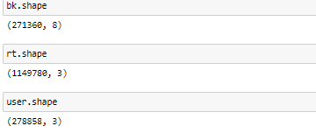
Shape & size of data set.
Books-In Books data set there are having 271360 rows and 8 column.
Ratings- in ratings set there are having 11449780 and 3 column.
Users- In users data set there are having 278858 and 3 column.

Slide 7
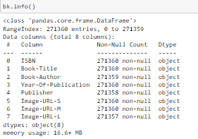
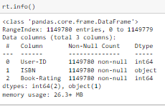
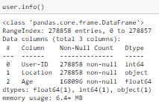
Data set information

Slide 8
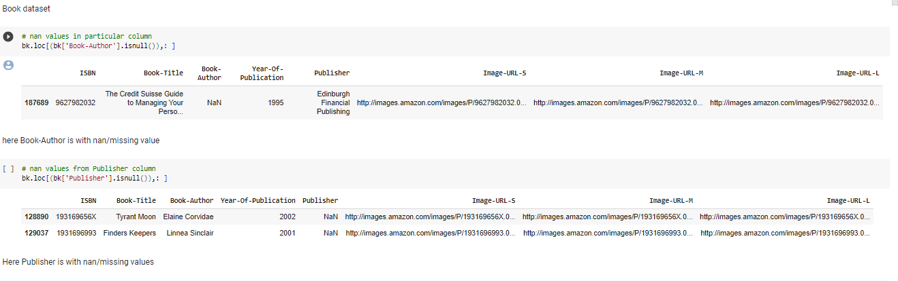
Data cleaning

Slide 9
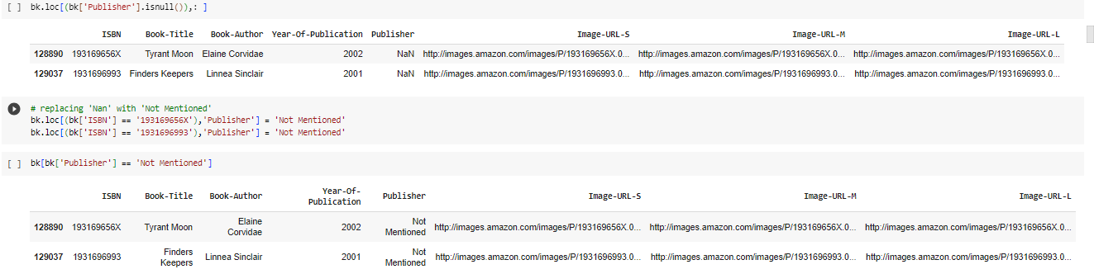
we have treat All the Missing values in publisher & Book Author column.

Slide 10
Exploratory data analysis (EDA)

Slide 11
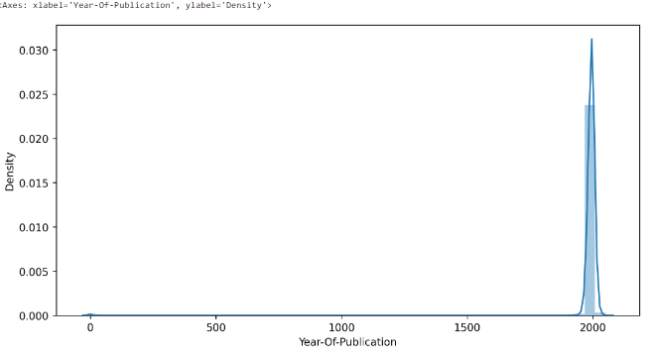
Data Visualizations
We can see the maximum books has published in between 2000

Slide 12
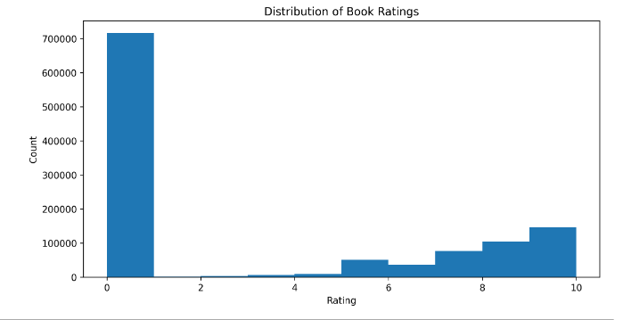
Distribution of books ratings
we can see maximum of the users did rating in between 0 to 1 & minimum rating did in between 3 to 4

Slide 13
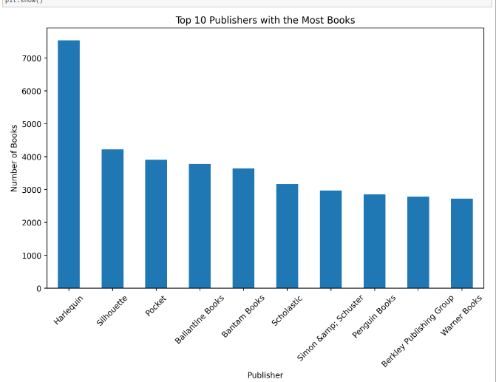
Top 10 publishers with the most books
Top 10 publishers with most books in this ‘Harlequin’ has published most books.

Slide 14
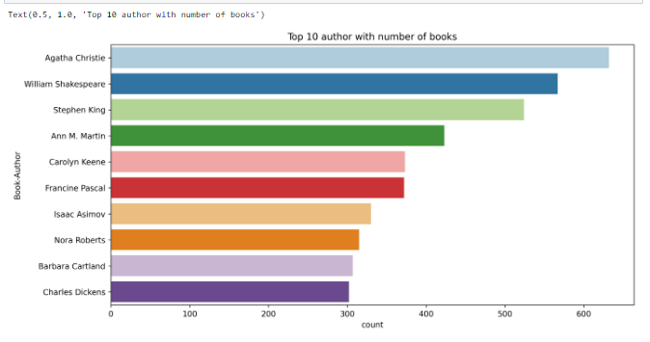
Top 10 Authors with the most books
Top 10 books rated by users.

Slide 15
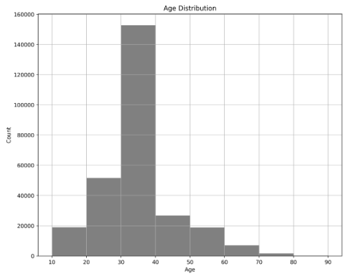
Age distributions of users_data
Maximum users age is in between 30-40.

Slide 16
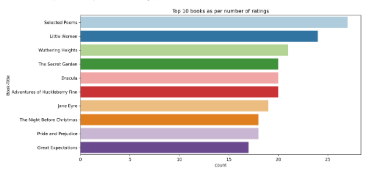
Top 10 books as per the number of ratings
This is top 10 books rated by users.

Slide 17
popularity recommendation
It is a type of recommendation system which works on the principle of popularity and or anything which is in trend. These systems check about the books which are in trend or are most popular among the users and directly recommend them.

Slide 18
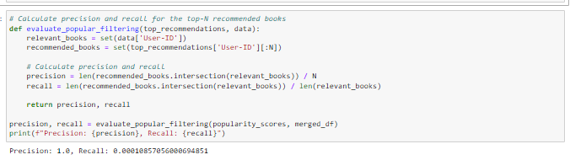
popularity recommendation evaluation
Precision is 1.0, This suggests that the system is highly accurate in terms of relevance.
A low recall value indicates that the system is not effective at finding all relevant books. A low recall value means it suggests that the popularity-based system is not able to recommend a large portion of the books that users in the test dataset might find relevant.

Slide 19
Collaborative Filtering evaluation Recommender System
Collaborative Filtering: Collaborative filtering is a recommendation technique that relies on user-item interactions or user-item ratings to make recommendations. SVD is often used in collaborative filtering to reduce the dimensionality of the user-item interaction matrix. By applying SVD to this matrix, you can uncover latent factors that represent user preferences and item characteristics. These latent factors are then used to make recommendations by predicting how a user would rate or interact with items they haven't seen before.

Slide 20
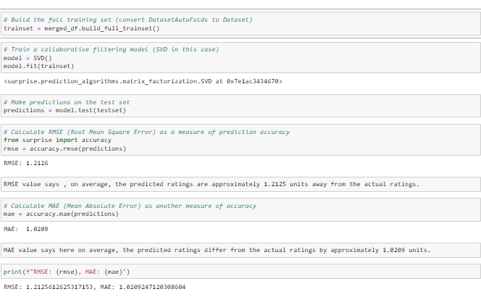

Slide 21
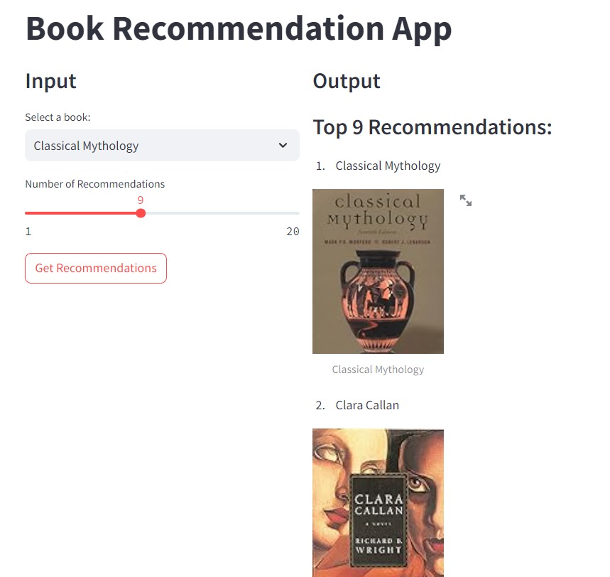
Screen shot from deployed Book recommendation app

